Slide 1
Windows Phone 7
A Simple and Streamlined GUI

Slide 2
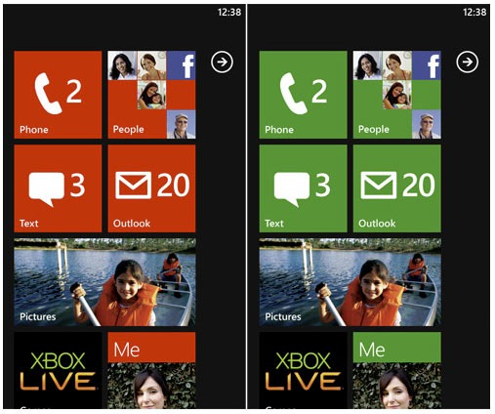
The Home Screen
The large icons prevent unwanted actions through false touches.
The large icons and symbols make it easy to distinguish each button’s functions.
The contrasting colours make the symbols clear and the writing legible.
It organizes the top objectives into a single top level screen.
It can be modified based on user use.

Slide 3
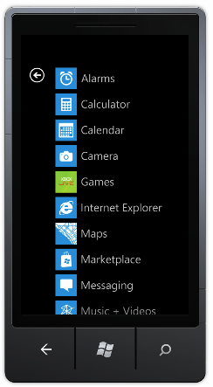
The Main Menu
The main menu has all the programs installed on the phone listed in alphabetical order
The simple symbols in the icons tell what the program does
The colour contrast makes the text very easy to read
The icons are still large enough to touch without hitting the wrong icon

Slide 4

The Overall Design
The large icons on the home screen prevent user eye strain as does the large clear typeset on the main menu
With the exception of the media player, the menus never go more then three layers in preventing the user from forgetting what they were doing
It fits the “20 second” rule
The home screen allows users to place their high frequency applications to be accessed right away, eliminating unnecessary gestures
It deserves the words “Don’t Panic” written in large friendly letters on the cover of the phone

Slide 5
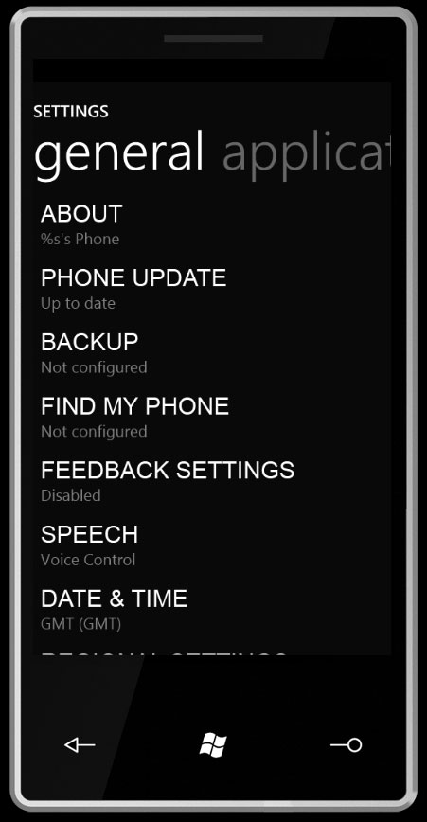
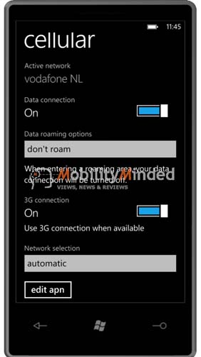
Changing Settings
All settings can be accessed with two gestures
The settings screen in highly legible with a high contrast typeset
Any setting is changed by sliding a slider with your finger
High frequency items can be moved to the home screen by holding down your figure and dragging it back to the home screen.

Slide 6
Conclusion
Windows Phone 7 is a unique UI that is extremely simple to use
It meets all the elements of a good UI with it’s effective use of colours, It’s high readability text and simple yet effective symbols
It also meets the twenty second rule by having access to all applications in just two gestures

Slide 7
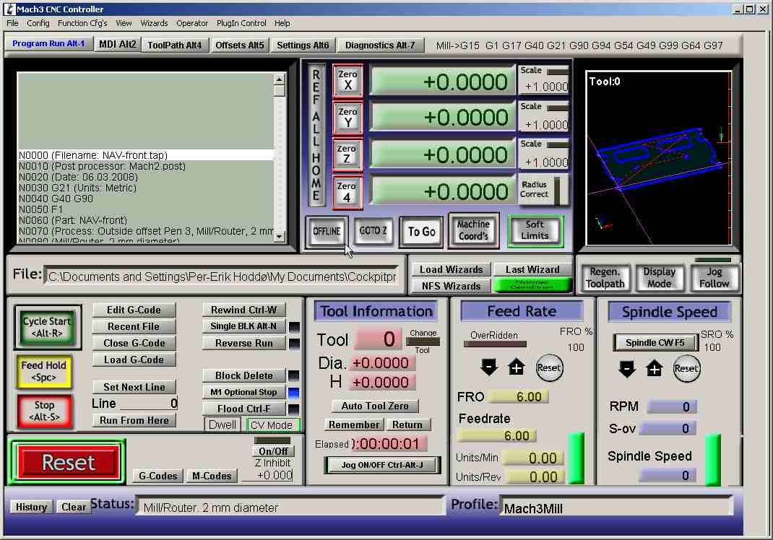
Notes:
Designing for people
It has color
It has a lot of information all in one place
There is a decent amount of eye movement
Designing for Usage
For a machinist, this UI is great
Has all of the information all in one place
Designing for Workflow
Most common things are front in center (ie. Reset)
Everything is clearly labeled
Has lots of help (although usually not needed)
Consistent

Slide 8
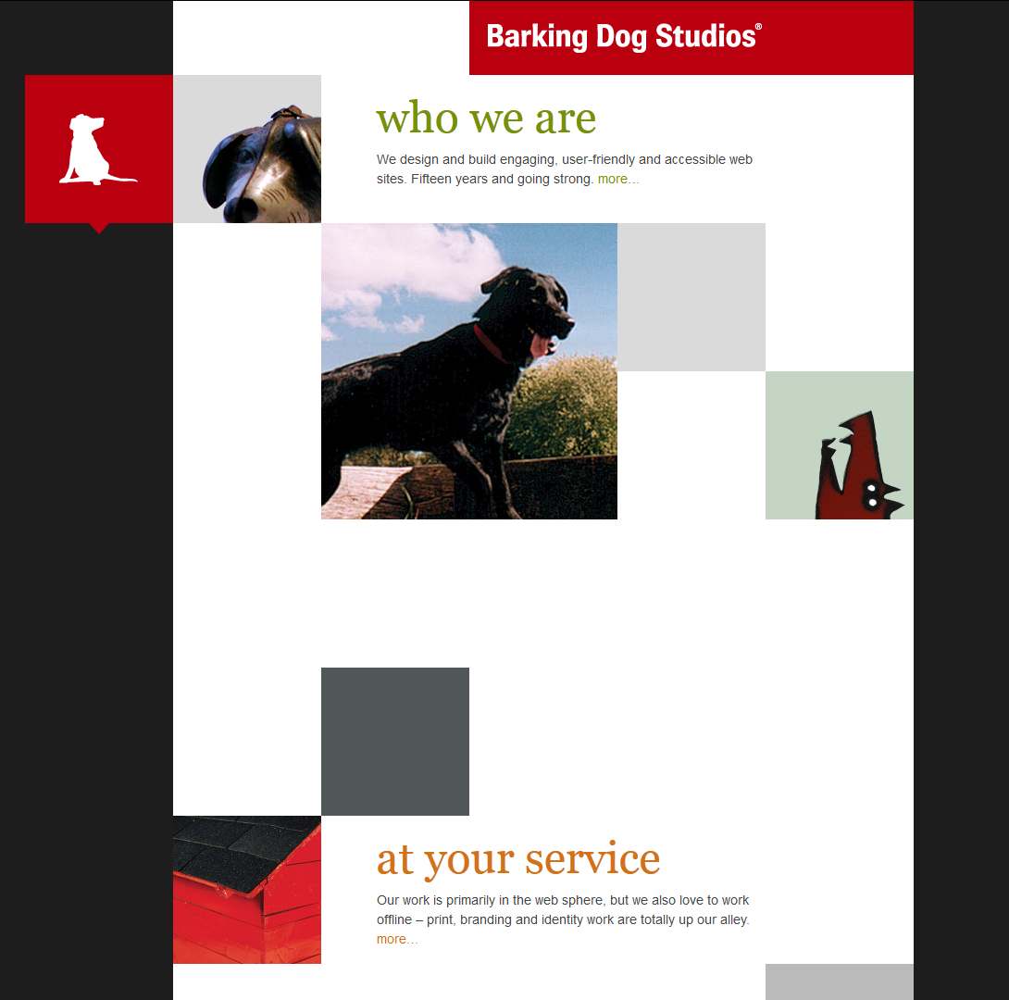
Notes:
Designing for people
Nice colors and contrast
Images can attract interest
Very eye catching
Does not assume that people read
Assuming you only scroll down, the UI makes sense
UI is designed to be used by a mouse which makes sense for their customer base
Designing for Usage
The website is not logical or straightforward
Assuming the user only scrolls down, the workflow works
Designing for Workflow
User, without prior knowledge, will have no idea how to traverse the website
No help documentation if the user gets stuck
Buttons are not labeled or intuitive

